Slide 1
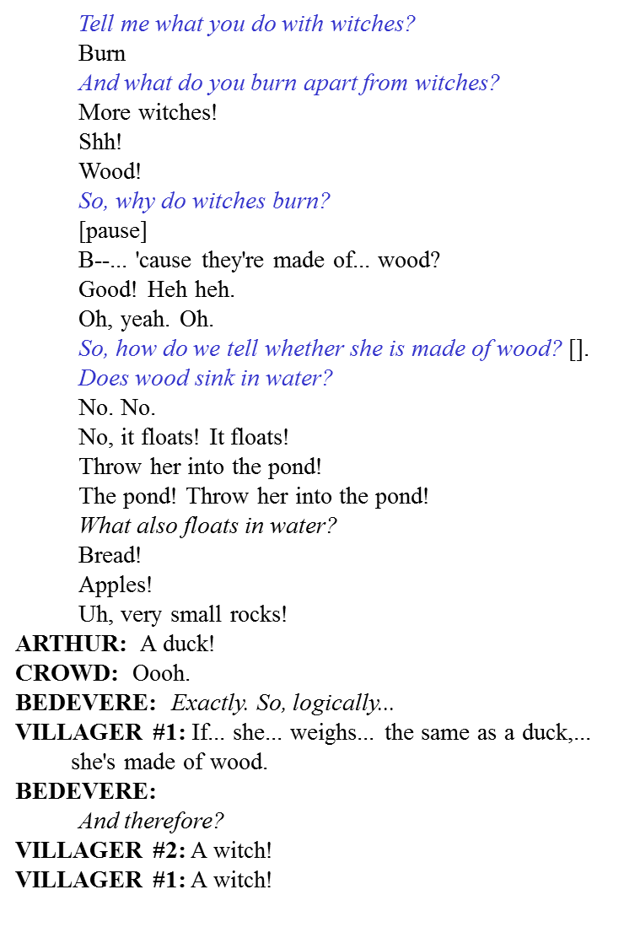
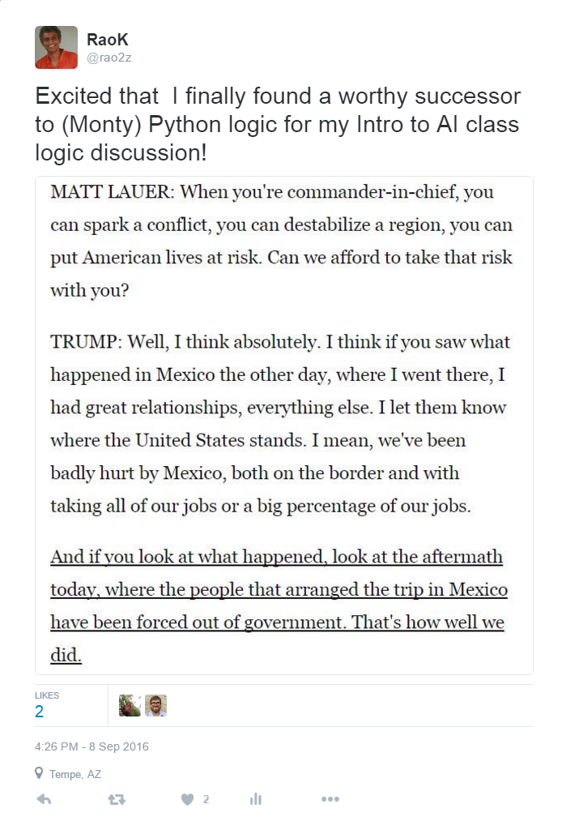

Slide 2

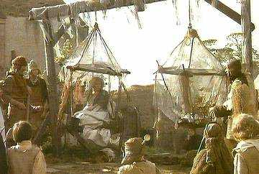
Tell me what you do with witches?
Burn
And what do you burn apart from witches?
More witches!
Shh!
Wood!
So, why do witches burn?
[pause]
B--... 'cause they're made of... wood?
Good! Heh heh.
Oh, yeah. Oh.
So, how do we tell whether she is made of wood? [].
Does wood sink in water?
No. No.
No, it floats! It floats!
Throw her into the pond!
The pond! Throw her into the pond!
What also floats in water?
Bread!
Apples!
Uh, very small rocks!
ARTHUR: A duck!
CROWD: Oooh.
BEDEVERE: Exactly. So, logically...
VILLAGER #1: If... she... weighs... the same as a duck,...
she's made of wood.
BEDEVERE:
And therefore?
VILLAGER #2: A witch!
VILLAGER #1: A witch!
Python logic

Slide 3
We have Artificial Intelligence, but can we get Artificial Wisdom?

Slide 4
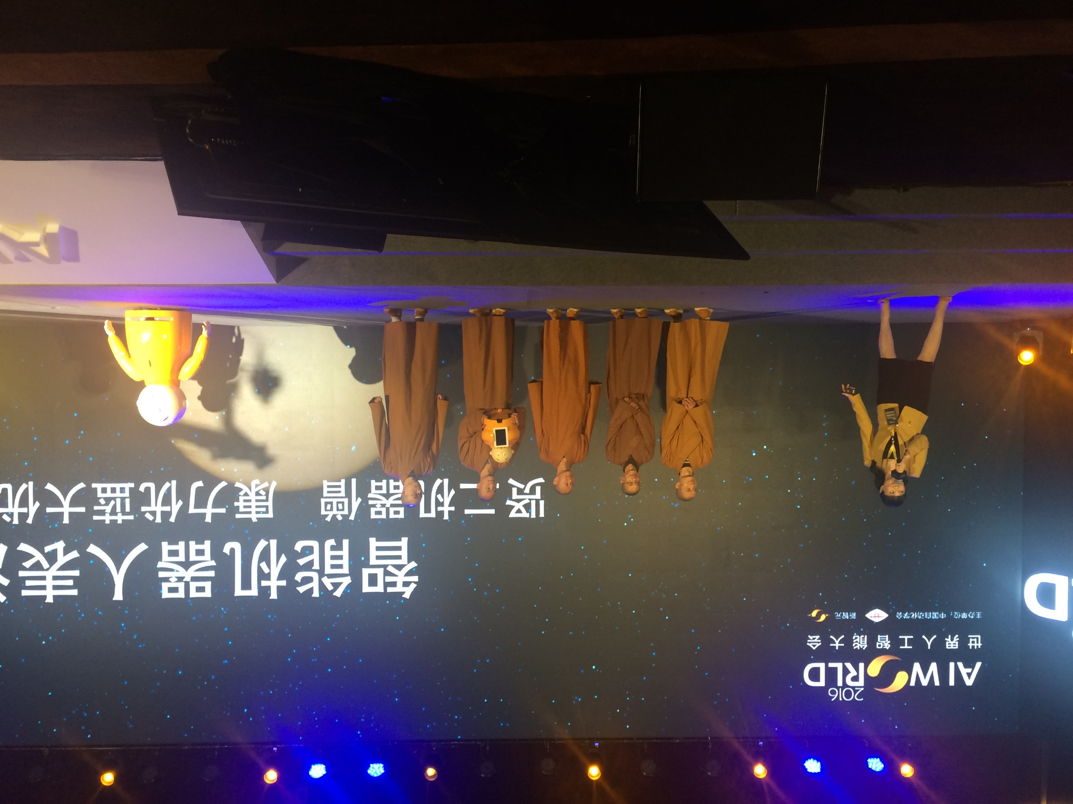

Slide 5
We have Artificial Intelligence, but can we get Artificial Wisdom?
Is AI a Science or a Technology?

Slide 6
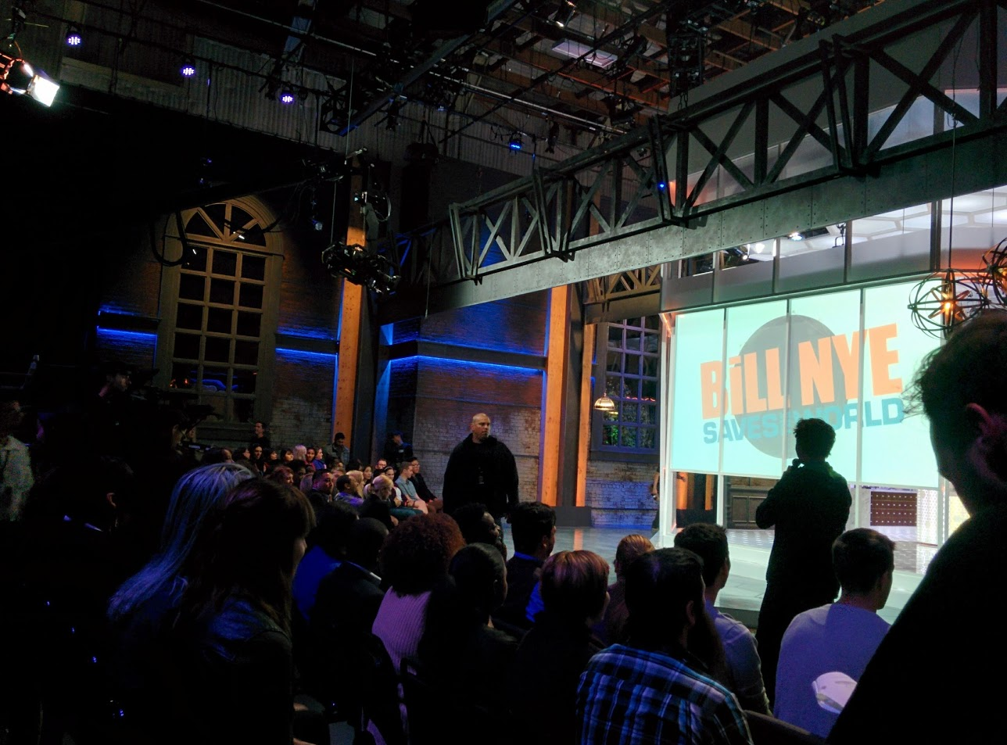


Slide 7
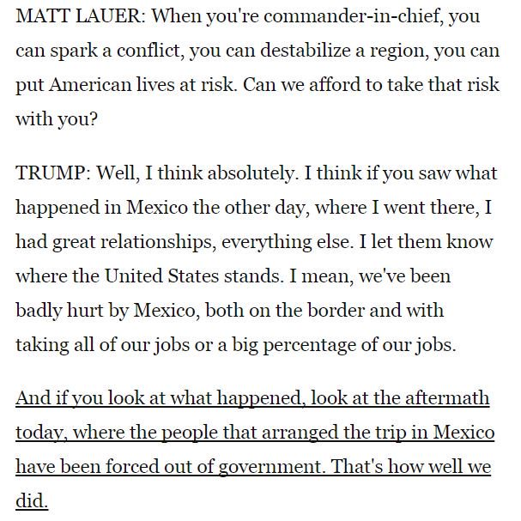

Slide 8
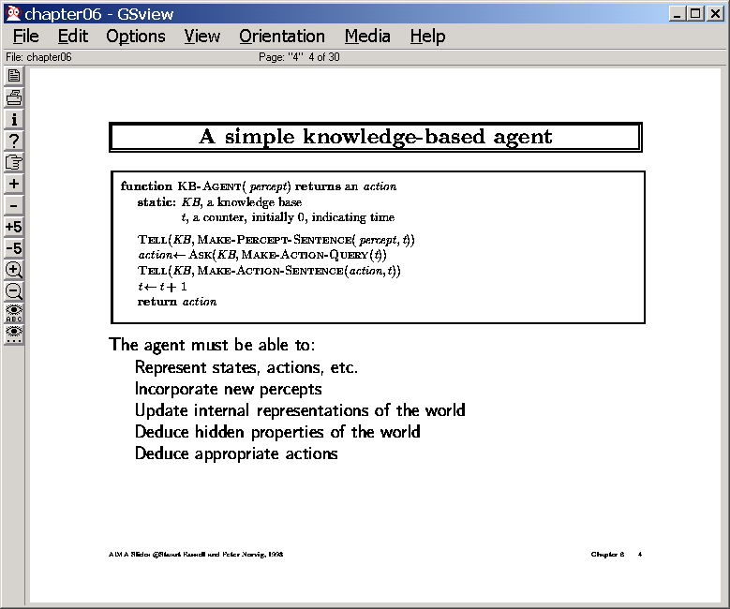
Representation
Reasoning

Slide 9
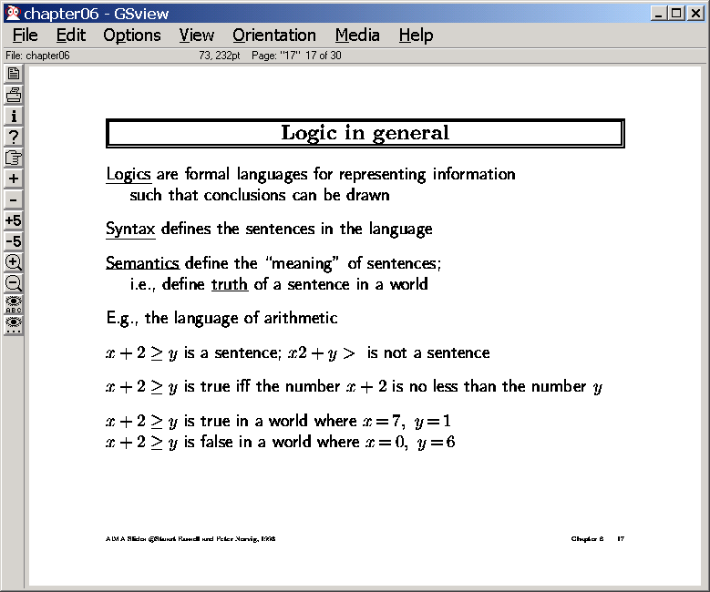

Slide 10
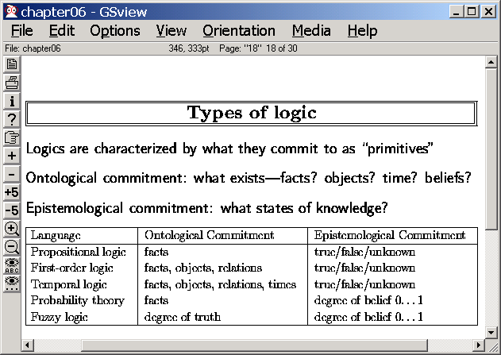
Facts
Objects
relations
FOPC
Prob
FOPC
Ontological
commitment
Prob
prop
logic
Prop
logic
facts
t/f/u
Epistemological
commitment
Deg
belief
Assertions;
t/f

Slide 11
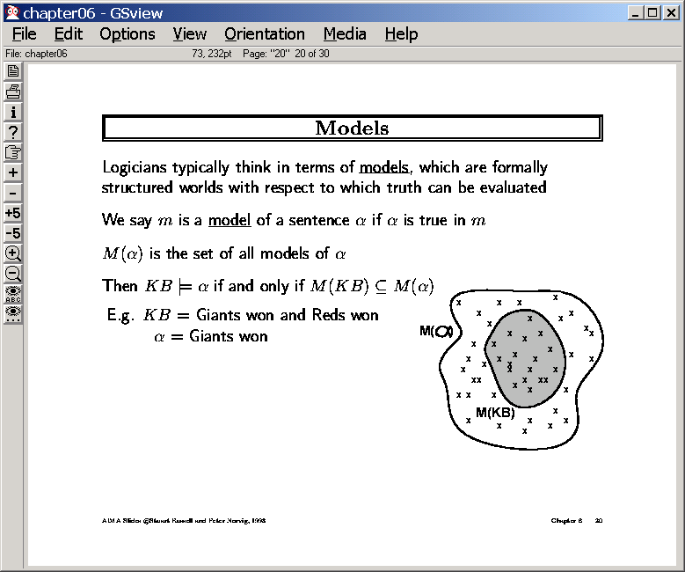
Think of a sentence as the
stand-in for a set of worlds
(where it is true)

Slide 12
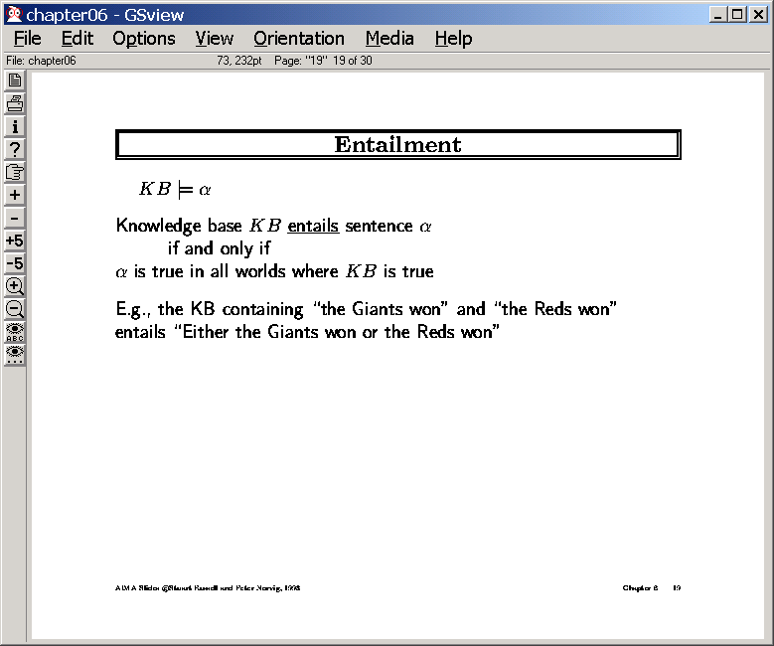

Slide 13
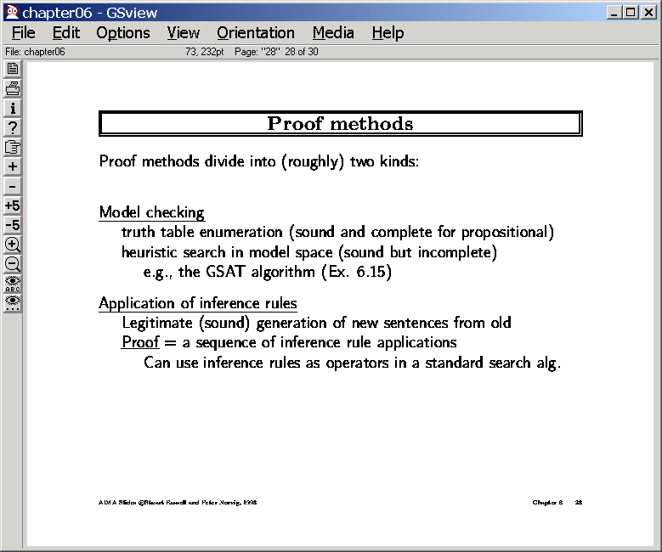

Slide 14
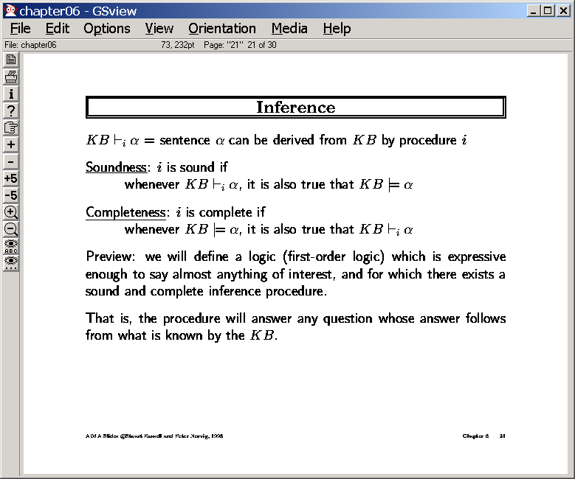

Slide 15
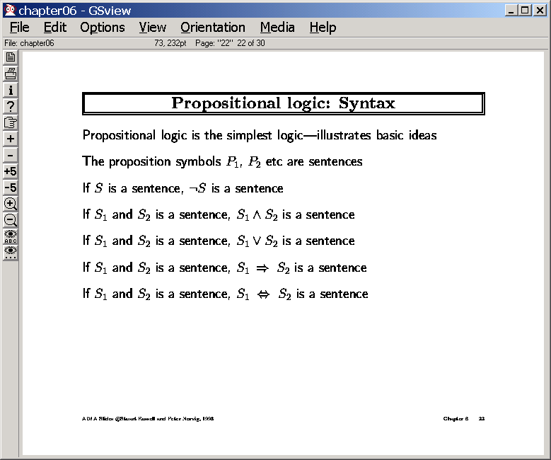

Slide 16
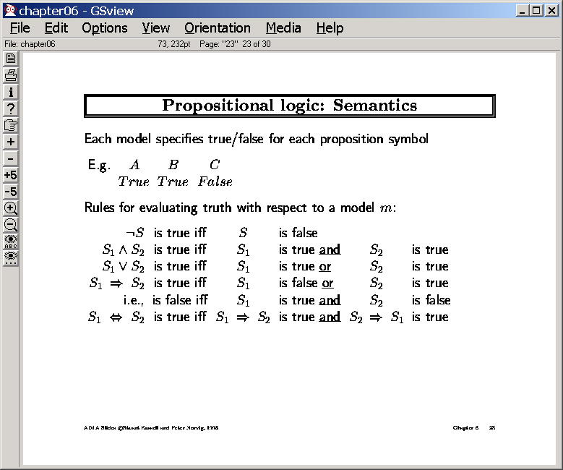

Slide 17
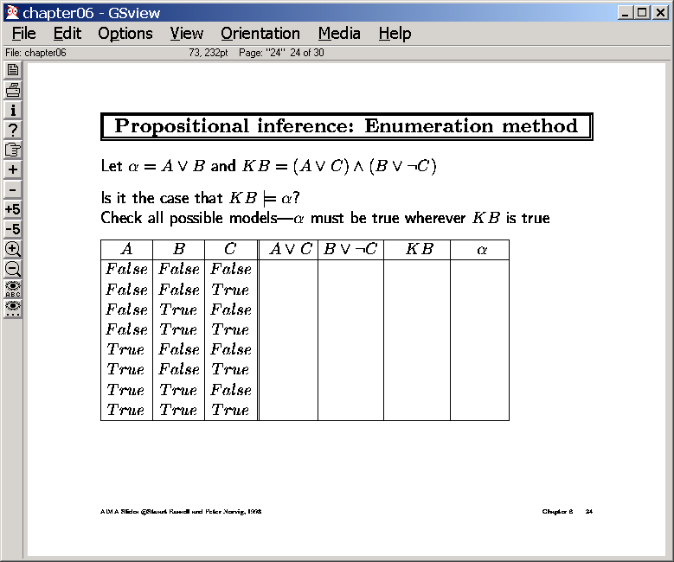

Slide 18
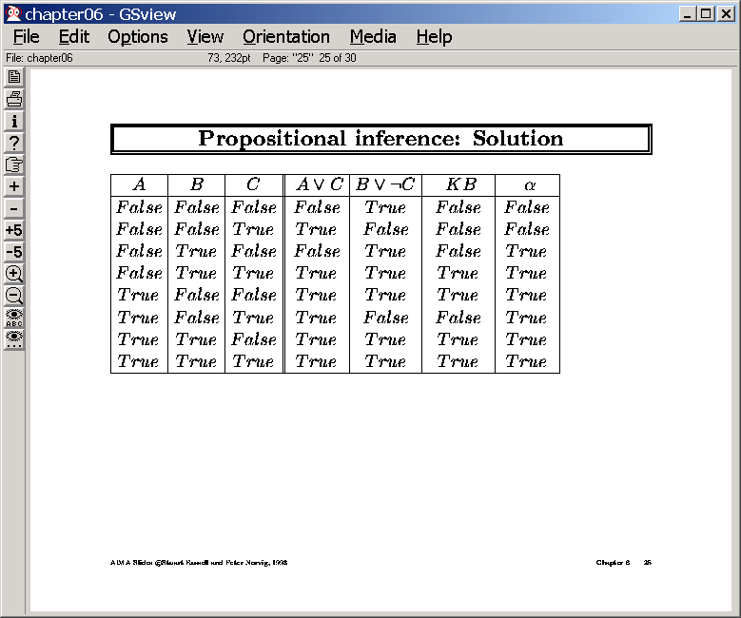
is true in all worlds (rows)
Where KB is true…so it is entailed

Slide 19
Proof by model checking
KB&~α
False
False
False
False
False
False
False
False
So, to check if KB entails α,
negate α, add it to the KB,
try to show that the resultant (propositional) theory
has no solutions (must have to use systematic methods)

Slide 20
Inference rules
Kb true but theorem not true ☹
Sound (but incomplete)
Modus Ponens
A=>B, A |= B
Modus tollens
A=>B,~B |= ~A
Abduction (??)
A => B,~A |= ~B
Chaining
A=>B,B=>C |= A=>C
Complete (but unsound)
“Yes m’am” logic
A | B | A=>B | KB | ~A
T | T | T | F | F
T | F | F | F | F
F | T | T | F | T
F | F | T | T | T
How about SOUND & COMPLETE?
--Resolution (needs normal forms)

Slide 21
Need something that does case analysis
If Will goes Jane will go
W=>J
If Will doesn’t go, Jane will still go
~W=>J
Will Jane go?
|= J?
Can Modus Ponens derive it?

Slide 22
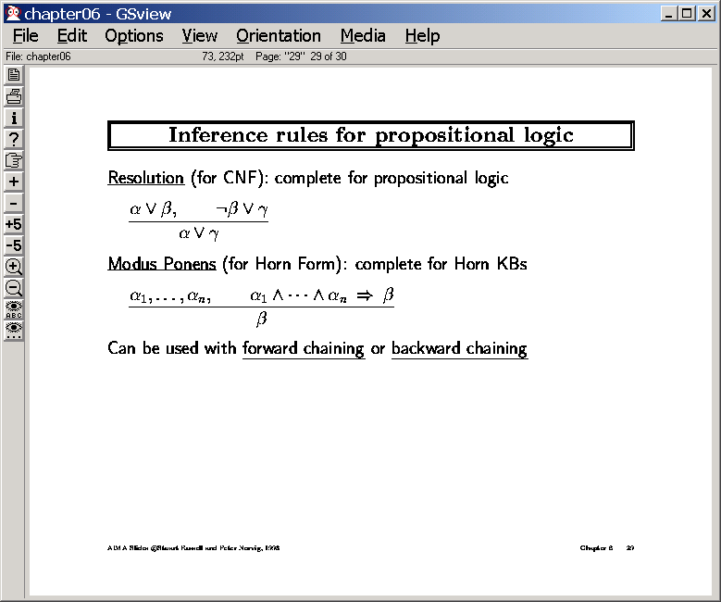
Modus ponens, Modus Tollens
etc are special cases of resolution!
Forward
apply resolution steps
until the fact f you want to
prove appears as a resolvent
Backward (Resolution Refutation)
Add negation of the fact f you
want to derive to KB
apply resolution steps
until you derive an empty clause

Slide 23
If Will goes, Jane will go
~W V J
If doesn’t go, Jane will still go
W V J
Will Jane go?
|= J?
J V J =J
Don’t need to use other
equivalences if we use
resolution in refutation style
~J ~W
~ W V J
W V J
J

Slide 24
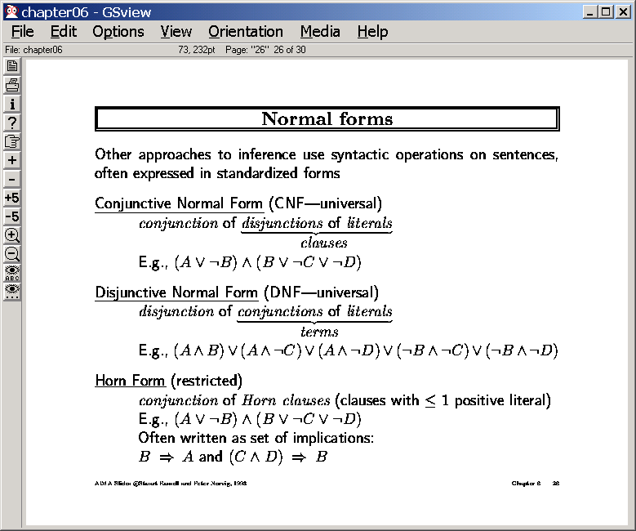
Aka the product of sums form
From CSE/EEE 120
Aka the sum of products form
A&B => CVD is non-horn
Prolog without variables
and without the cut operator
Is doing horn-clause theorem
proving
For any KB in horn form,
modus ponens is a sound
and complete inference

Slide 25
Conversion to CNF form
ANY propositional logic sentence
can be converted into CNF form
Try: ~(P&Q)=>~(R V W)
CNF clause= Disjunction of literals
Literal = a proposition or a negated proposition
Conversion:
Remove implication
Pull negation in
Use demorgans laws to distribute disjunction over conjunction
Separate conjunctions
into clauses

Slide 26
Need for resolution
Resolution does
case analysis
Yankees win, it is Destiny
~YVD
Dbacks win, it is Destiny
~Db V D
Yankees or Dbacks win
Y V Db
Is it Destiny either way?
|= D?
Can Modus Ponens derive it?
Not until Sunday, when Db won
DVD == D
DVY
Don’t need to use other
equivalences if we use
resolution in refutation style
~D ~Y
~Y V D
~Db V D
Y V Db
Db
D

Slide 27
Solving problems using propositional logic
Need to write what you know as propositional formulas
Theorem proving will then tell you whether a given new sentence will hold given what you know
Three kinds of queries
Is my knowledge base consistent? (i.e. is there at least one world where everything I know is true?) Satisfiability
Is the sentence S entailed by my knowledge base? (i.e., is it true in every world where my knowledge base is true?)
Is the sentence S consistent/possibly true with my knowledge base? (i.e., is S true in at least one of the worlds where my knowledge base holds?)
S is consistent if ~S is not entailed

Slide 28
Steps in Resolution Refutation
Is there search in inference?
Yes!!
Many possible inferences can be done
Only few are actually relevant
--Heuristic: Set of Support
At least one of the resolved
clauses is a goal clause, or
a descendant of a clause
derived from a goal clause
-- Used in the example here!!
Consider the following problem
If the grass is wet, then it is either raining or the sprinkler is on
GW => R V SP ~GW V R V SP
If it is raining, then Timmy is happy
R => TH ~R V TH
If the sprinklers are on, Timmy is happy
SP => TH ~SP V TH
If timmy is happy, then he sings
TH => SG ~TH V SG
Timmy is not singing
~SG ~SG
Prove that the grass is not wet
|= ~GW? GW
SG V SP
TH V SP
R V SP
SG
SP
TH

Slide 30
Search in Resolution
Idea 1: Set of Support: At least one of C1 or C2 must be either the goal clause or a clause derived by doing resolutions on the goal clause (*COMPLETE*)
Idea 2: Linear input form: Atleast one of C1 or C2 must be one of the clauses in the input KB (*INCOMPLETE*)
Convert the database into clausal form D_{c}
Negate the goal first, and then convert it into clausal form D_{G}
Let D = D_{c}+ D_{G}
Loop
Select a pair of Clauses C1 and C2 from D
Different control strategies can be used to select C1 and C2 to reduce number of resolutions tries
Resolve C1 and C2 to get C12
If C12 is empty clause, QED!! Return Success (We proved the theorem; )
D = D + C12
End loop
If we come here, we couldn’t get empty clause. Return “Failure”
Finiteness is guaranteed if we make sure that:
we never resolve the same pair of clauses more than once; AND
we use factoring, which removes multiple copies of literals from a clause (e.g. QVPVP => QVP)

Slide 31
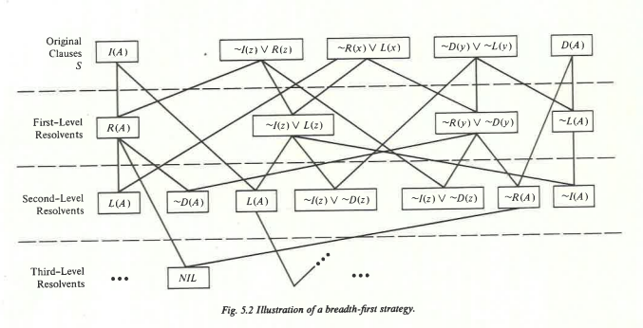
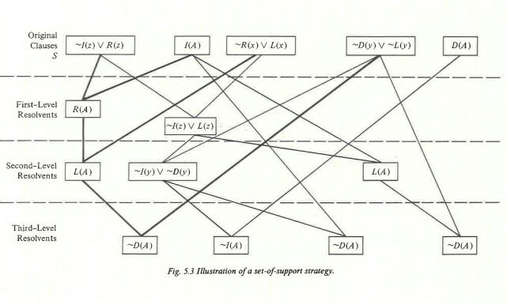
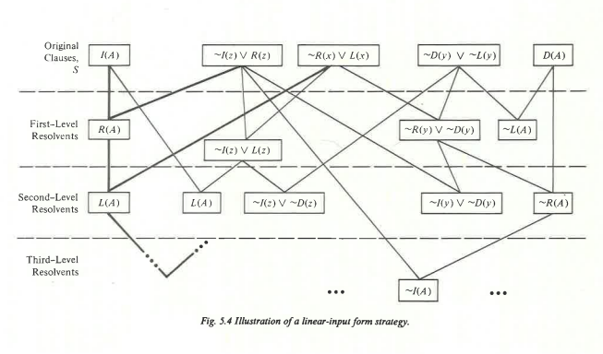
Comparing Set-of-Support
And Linear Input Form
Strategies to full search

Slide 32
Mad chase for empty clause…
You must have everything in CNF clauses before you can resolve
Goal must be negated first before it is converted into CNF form
Goal (the fact to be proved) may become converted to multiple clauses (e.g. if we want to prove P V Q, then we get two clauses ~P ; ~Q to add to the database
Resolution works by resolving away a single literal and its negation
PVQ resolved with ~P V ~Q is not empty!
In fact, these clauses are not inconsistent (P true and Q false will make sure that both clauses are satisfied)
PVQ is negation of ~P & ~Q. The latter will become two separate clauses--~P , ~Q. So, by doing two separate resolutions with these two clauses we can derive empty clause

Slide 33
Complexity of Propositional Inference
Any sound and complete inference procedure has to be Co-NP-Complete (since model-theoretic entailment computation is Co-NP-Complete (since model-theoretic satisfiability is NP-complete))
Given a propositional database of size d
Any sentence S that follows from the database by modus ponens can be derived in linear time
If the database has only HORN sentences (sentences whose CNF form has at most one +ve clause; e.g. A & B => C), then MP is complete for that database.
PROLOG uses (first order) horn sentences
Deriving all sentences that follow by resolution is Co-NP-Complete (exponential)
Anything that follows by unit-resolution can be derived in linear time.
Unit resolution: At least one of the clauses should be a clause of length 1

Slide 34
Solving problems using propositional logic
Need to write what you know as propositional formulas
Theorem proving will then tell you whether a given new sentence will hold given what you know
Three kinds of queries
Is my knowledgebase consistent? (i.e. is there at least one world where everything I know is true?) Satisfiability
Is the sentence S entailed by my knowledge base? (i.e., is it true in every world where my knowledge base is true?)
Is the sentence S consistent/possibly true with my knowledge base? (i.e., is S true in at least one of the worlds where my knowledge base holds?)
S is consistent if ~S is not entailed
But cannot differentiate between degrees of likelihood among possible sentences

Slide 35
Example
Pearl lives in Los Angeles. It is a high-crime area. Pearl installed a burglar alarm. He asked his neighbors John & Mary to call him if they hear the alarm. This way he can come home if there is a burglary. Los Angeles is also earth-quake prone. Alarm goes off when there is an earth-quake.
Burglary => Alarm
Earth-Quake => Alarm
Alarm => John-calls
Alarm => Mary-calls
If there is a burglary, will Mary call?
Check KB & B |= M
If Mary didn’t call, is it possible that Burglary occurred?
Check KB & ~M doesn’t entail ~B

Slide 36
Satisfiability Problems
Given a set of propositional formulas, find a model (i.e., T/F values for propositions that satisfy all the formulas)
This is a “constraint satisfaction” problem
Given constraints on available classes and your class requirements, find a class schedule for you
Given a chess board, place 8 queens on it so no pair of them conflict
Given a sudoku board, solve it!
Given a digital circuit, verify that it works as advertised..
Boolean Satisfiability is NP-Complete
Typically, we consider SAT problems after all constraints are converted into CNF form
If we also put a restriction on the size of the clauses—saying all clauses are of length k, then we get k-SAT problems
Complexity?
1-SAT
2-SAT
3-SAT
Problem
Clauses
1. (p,s,u)
2. (~p, q)
3. (~q, r)
4. (q,~s,t)
5. (r,s)
6. (~s,t)
7. (~s,u)

Slide 37
Model-checking by Stochastic Hill-climbing
Clauses
1. (p,s,u)
2. (~p, q)
3. (~q, r)
4. (q,~s,t)
5. (r,s)
6. (~s,t)
7. (~s,u)
Applying min-conflicts
idea to Satisfiability
Start with a model (a random t/f assignment to propositions)
For I = 1 to max_flips do
If model satisfies clauses then return model
Else clause := a randomly selected clause from clauses that is false in model
With probability p whichever symbol in clause maximizes the number of satisfied clauses /*greedy step*/
With probability (1-p) flip the value in model of a randomly selected symbol from clause /*random step*/
Return Failure
Consider the assignment “all false”
-- clauses 1 (p,s,u) & 5 (r,s) are violated
--Pick one—say 5 (r,s)
[if we flip r, 1 (remains) violated
if we flip s, 4,6,7 are violated]
So, greedy thing is to flip r
we get all false, except r
otherwise, pick either randomly
Remarkably good in practice!!
--So good that people startedwondering if there actually are any hard problems out there

Slide 38
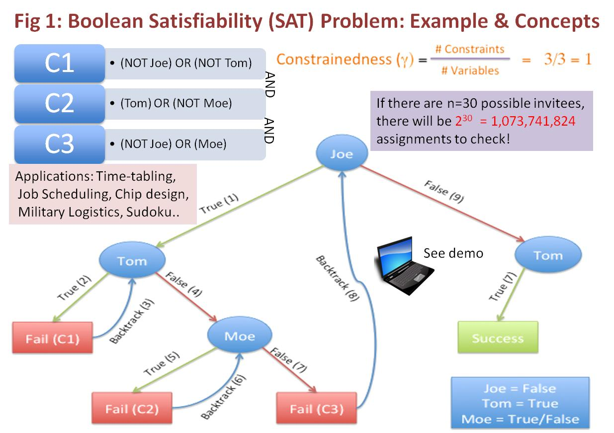
[From Soumya]

Slide 39
CSP or Multi-valued version of SAT
A (discrete) constraint satisfaction problem is given by
A set of discrete variables, and their domains
Can be non-boolean
A set of constraints (or legal compound assignments over variables)
The goal is to find an assignment for all variables that satisfy all constraints
CSP can be compiled into SAT and vice versa

Slide 40
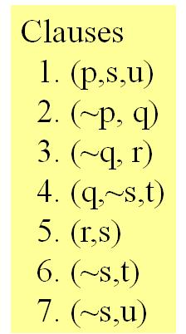
Solving SAT Problems
Basic Search
Two Improvements
(Depth-first) Search in the space of partial assignments [Breadth-first and IDDFS don’t make sense since all solutions are at leaf level!]
Start with null assignment
Keep going until we have an assignment that satisfies all clauses
If some variables are still not assigned, that means they can be either T of F
If a partial assignment violates a clause, fail and backtrack (‘cuz you can make a dead assignment comeback alive..)
What do we branch on?
Variables to assign next [Don’t need to branch—just pick any order. But a good order can improve efficiency significantly!]
Values (T/F) for that variable
Forward Checking: If you can see that a partial assignment will leave a future variable unassignable, fail and backtrack..
E.g. p1→p1000; p2→~p1000;…..
Currently we have assigned p1 True, p2 true
This is where unit resolution is useful!
In fact, as soon as we assign p1 true, unit resolution (aka propagation) derives p2 false
Variable Ordering: Most constrained first
Idea: To decide whether to branch on p or q, estimate the size of the theory that results if we branch on p and do unit resolution; and the same for q. whichever gives smaller theory wins.. [Costly variable order selection—but still wins!]

Slide 41
DPLL Example
Pick p;
set p=true
unit propagation
(p,s,u) satisfied (remove)
p;(~p,q) → q derived; set q=T
(~p,q) satisfied (remove)
(q,~s,t) satisfied (remove)
q;(~q,r)→r derived; set r=T
(~q,r) satisfied (remove)
(r,s) satisfied (remove)
pure literal elimination
in all the remaining clauses, s occurs negative
set ~s=True (i.e. s=False)
At this point all clauses satisfied. Return
p=T,q=T;r=T;s=False
Satz picks the variable
Setting of which leads
To most unit resolutions
Clauses
(p,s,u)
(~p, q)
(~q, r)
(q,~s,t)
(r,s)
(~s,t)
(~s,u)
s was not Pure
in all clauses but only
the remaining ones
If there is a model,
PLE will find a model
(not all models)

Slide 42
Connection between Entailment and Satisfiability
The Boolean Satisfiability problem is closely connected to Propositional entailment
Specifically, propositional entailment is the “conjugate” problem of boolean satisfiability (since we have to show that KB & ~f has no satisfying model to show that KB |= f)
Of late, our ability to solve very large scale satisfiability problems has increased quite significantly

Slide 43
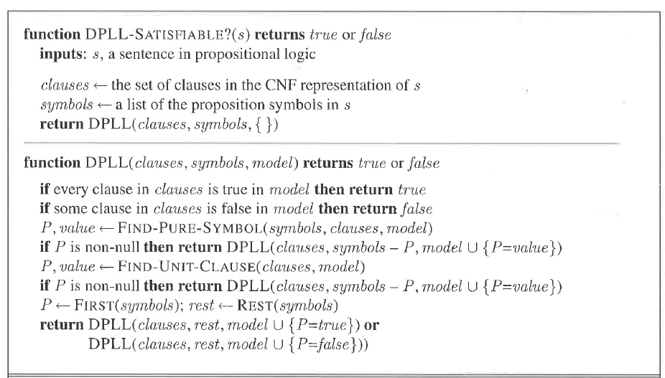
Davis-Putnam-Logeman-Loveland Procedure
Pure literal elimination:
In all remaining clauses
if a variable occurs with
single polarity, just
set it to that polarity
←detect failure

Slide 44
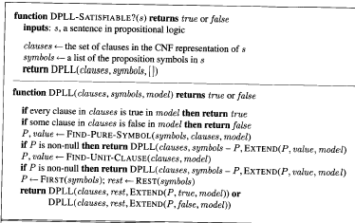
Davis-Putnam-Logeman-Loveland Procedure
←detect failure

Slide 45
Solving problems using propositional logic
Need to write what you know as propositional formulas
Theorem proving will then tell you whether a given new sentence will hold given what you know
Three kinds of queries
Is my knowledgebase consistent? (i.e. is there at least one world where everything I know is true?) Satisfiability
Is the sentence S entailed by my knowledge base? (i.e., is it true in every world where my knowledge base is true?)
Is the sentence S consistent/possibly true with my knowledge base? (i.e., is S true in at least one of the worlds where my knowledge base holds?)
S is consistent if ~S is not entailed
But cannot differentiate between degrees of likelihood among possible sentences

Slide 46
Example
Pearl lives in Los Angeles. It is a high-crime area. Pearl installed a burglar alarm. He asked his neighbors John & Mary to call him if they hear the alarm. This way he can come home if there is a burglary. Los Angeles is also earth-quake prone. Alarm goes off when there is an earth-quake.
Burglary => Alarm
Earth-Quake => Alarm
Alarm => John-calls
Alarm => Mary-calls
If there is a burglary, will Mary call?
Check KB & E |= M
If Mary didn’t call, is it possible that Burglary occurred?
Check KB & ~M doesn’t entail ~B

Slide 47
Facts
Objects
relations
FOPC
Prob
FOPC
Ontological
commitment
Prob
prop
logic
Prop
logic
facts
t/f/u
Epistemological
commitment
Deg
belief
Assertions;
t/f

Slide 48
Example (Real)
Pearl lives in Los Angeles. It is a high-crime area. Pearl installed a burglar alarm. He asked his neighbors John & Mary to call him if they hear the alarm. This way he can come home if there is a burglary. Los Angeles is also earth-quake prone. Alarm goes off when there is an earth-quake.
Pearl lives in real world where (1) burglars can sometimes disable alarms (2) some earthquakes may be too slight to cause alarm (3) Even in Los Angeles, Burglaries are more likely than Earth Quakes (4) John and Mary both have their own lives and may not always call when the alarm goes off (5) Between John and Mary, John is more of a slacker than Mary.(6) John and Mary may call even without alarm going off
Burglary => Alarm
Earth-Quake => Alarm
Alarm => John-calls
Alarm => Mary-calls
If there is a burglary, will Mary call?
Check KB & E |= M
If Mary didn’t call, is it possible that Burglary occurred?
Check KB & ~M doesn’t entail ~B
John already called. If Mary also calls, is it more likely that Burglary occurred?
You now also hear on the TV that there was an earthquake. Is Burglary more or less likely now?

Slide 49
Example (Real)
Pearl lives in Los Angeles. It is a high-crime area. Pearl installed a burglar alarm. He asked his neighbors John & Mary to call him if they hear the alarm. This way he can come home if there is a burglary. Los Angeles is also earth-quake prone. Alarm goes off when there is an earth-quake.
Pearl lives in real world where (1) burglars can sometimes disable alarms (2) some earthquakes may be too slight to cause alarm (3) Even in Los Angeles, Burglaries are more likely than Earth Quakes (4) John and Mary both have their own lives and may not always call when the alarm goes off (5) Between John and Mary, John is more of a slacker than Mary.(6) John and Mary may call even without alarm going off
Burglary => Alarm
Earth-Quake => Alarm
Alarm => John-calls
Alarm => Mary-calls
If there is a burglary, will Mary call?
Check KB & E |= M
If Mary didn’t call, is it possible that Burglary occurred?
Check KB & ~M doesn’t entail ~B
John already called. If Mary also calls, is it more likely that Burglary occurred?
You now also hear on the TV that there was an earthquake. Is Burglary more or less likely now?

Slide 50

How do we handle Real Pearl?
Potato in the tail-pipe
Omniscient & Eager way:
Model everything!
E.g. Model exactly the conditions under which John will call
He shouldn’t be listening to loud music, he hasn’t gone on an errand, he didn’t recently have a tiff with Pearl etc etc.
A & c1 & c2 & c3 &..cn => J
(also the exceptions may have interactions
c1&c5 => ~c9 )
Ignorant (non-omniscient) and Lazy (non-omnipotent) way:
Model the likelihood
In 85% of the worlds where there was an alarm, John will actually call
How do we do this?
Non-monotonic logics
“certainty factors”
“fuzzy logic”
“probability” theory?
Qualification and Ramification problems
make this an infeasible enterprise

Slide 51
Non-monotonic (default) logic
Prop calculus (as well as the first order logic we shall discuss later) are monotonic, in that once you prove a fact F to be true, no amount of additional knowledge can allow us to disprove F.
But, in the real world, we jump to conclusions by default, and revise them on additional evidence
Consider the way the truth of the statement “F: Tweety Flies” is revised by us when we are given facts in sequence: 1. Tweety is a bird (F)2. Tweety is an Ostritch (~F) 3. Tweety is a magical Ostritch (F) 4. Tweety was cursed recently (~F) 5. Tweety was able to get rid of the curse (F)
How can we make logic show this sort of “defeasible” (aka defeatable) conclusions?
Many ideas, with one being negation as failure
Let the rule about birds be Bird & ~abnormal => Fly
The “abnormal” predicate is treated special— if we can’t prove abnormal, we can assume ~abnormal is true
(Note that in normal logic, failure to prove a fact F doesn’t allow us to assume that ~F is true since F may be holding in some models and not in other models).
Non-monotonic logic enterprise involves (1) providing clean semantics for this type of reasoning and (2) making defeasible inference efficient

Slide 52
Certainty Factors
Associate numbers to each of the facts/axioms
When you do derivations, compute c.f. of the results in terms of the c.f. of the constituents (“truth functional”)
Problem: Circular reasoning because of mixed causal/diagnostic directions
Raining => Grass-wet 0.9
Grass-wet => raining 0.7
If you know grass-wet with 0.4, then we know raining which makes grass more wet, which….

Slide 53
Fuzzy Logic vs. Prob. Prop. Logic
Fuzzy Logic assumes that the word is made of statements that have different grades of truth
Recall the puppy example
Fuzzy Logic is “Truth Functional”—i.e., it assumes that the truth value of a sentence can be established in terms of the truth values only of the constituent elements of that sentence.
PPL assumes that the world is made up of statements that are either true or false
PPL is truth functional for “truth value in a given world” but not truth functional for entailment status.

Slide 54
Prop. Logic vs. Prob. Prop. Logic
Model theory for logic
Set of all worlds where the formula/KB holds
Each world is either a model or not
Proof theory/inference
Rather than enumerate all models, write KB sentences that constrain the models
Model theory for prob. Logic
For each world, give the probability p that the formula holds in that world
p(w)=0 means that world is definitely not a model
Otherwise, 0< p(w) <= 1
Sum of p(w) = 1
AKA Joint Probability Distribution—2^{n} – 1 numbers
Proof Theory
statements on subsets of propositions
E.g. p(A)=0.5; p(B|A)=0.7 etc
(Cond) Independences…
These constrain the joint probability distribution

Slide 55
Easy Special Cases
If there are no relations between the propositions (i.e., they can take values independently of each other)
Then the joint probability distribution can be specified in terms of probabilities of each proposition being true
Just n numbers instead of 2^{n}
If in addition, each proposition is equally likely to be true or false,
Then the joint probability distribution can be specified without giving any numbers!
All worlds are equally probable! If there are n props, each world will be 1/2^{n} probable
Probability of any propositional conjunction with m (< n) propositions will be 1/2^{m}
Is this a good world to live in?

Slide 56

Will we always need 2^{n} numbers?
If every pair of variables is independent of each other, then
P(x1,x2…xn)= P(xn)* P(xn-1)*…P(x1)
Need just n numbers!
But if our world is that simple, it would also be very uninteresting & uncontrollable (nothing is correlated with anything else!)
We need 2^{n} numbers if every subset of our n-variables are correlated together
P(x1,x2…xn)= P(xn|x1…xn-1)* P(xn-1|x1…xn-2)*…P(x1)
But that is too pessimistic an assumption on the world
If our world is so interconnected we would’ve been dead long back… ☹
A more realistic middle ground is that interactions between
variables are contained to regions.
--e.g. the “school variables” and the “home variables” interact only loosely
(are independent for most practical purposes)
-- Will wind up needing O(2^{k}) numbers (k << n)

Slide 57
10/16/15 discussion ended here.

Slide 58
Lots of work in SAT solvers
DPLL was the first (late 60’s)
Circa 1994 came GSAT (hill climbing search for SAT)
Circa 1997 came SATZ
Branch on the variable that causes the most unit propagation
Circa 1998-99 came RelSAT
~2000 came CHAFF
~2004: Siege
Current best can be found at
http://www.satcompetition.org/

Slide 59
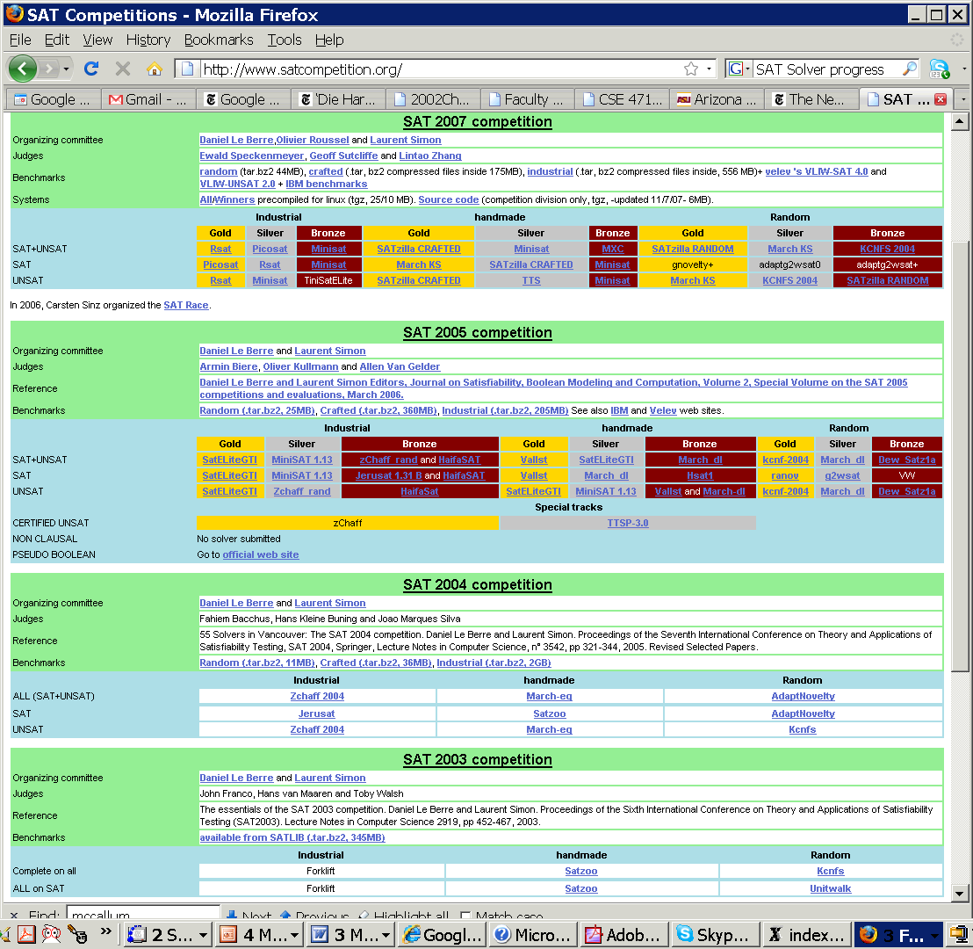

Slide 60

If most sat problems are easy, then exactly where are the hard ones?
?

Slide 61
Hardness of 3-sat as a function of #clauses/#variables
This is what
happens!
Probability that
there is a satisfying
assignment
Cost of solving
(either by finding
a solution or showing
there ain’t one)
You would
expect this
p=0.5
~4.3
#clauses/#variables

Slide 62
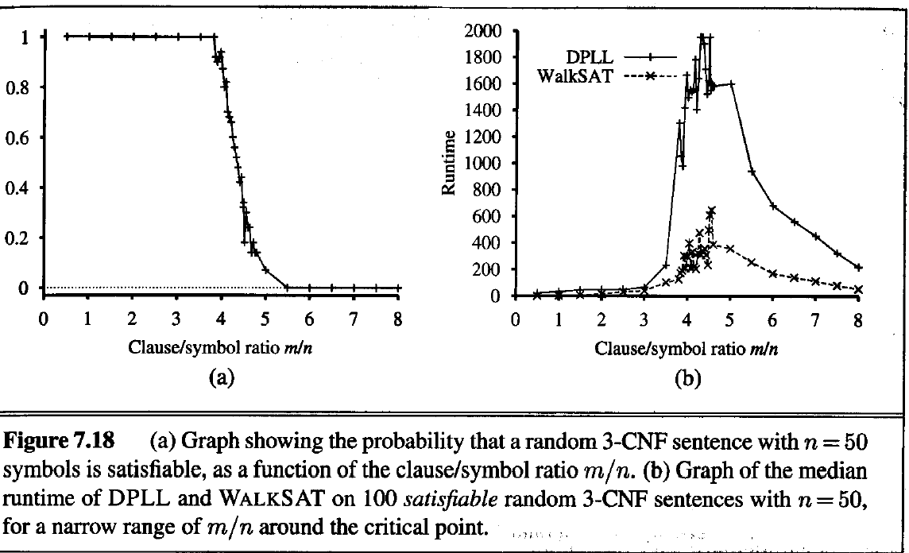
Phase Transition in SAT
Theoretically we only know that phase transition ratio
occurs between 3.26 and 4.596.
Experimentally, it seems to be close to 4.3
(We also have a proof that 3-SAT has sharp threshold)

Slide 63
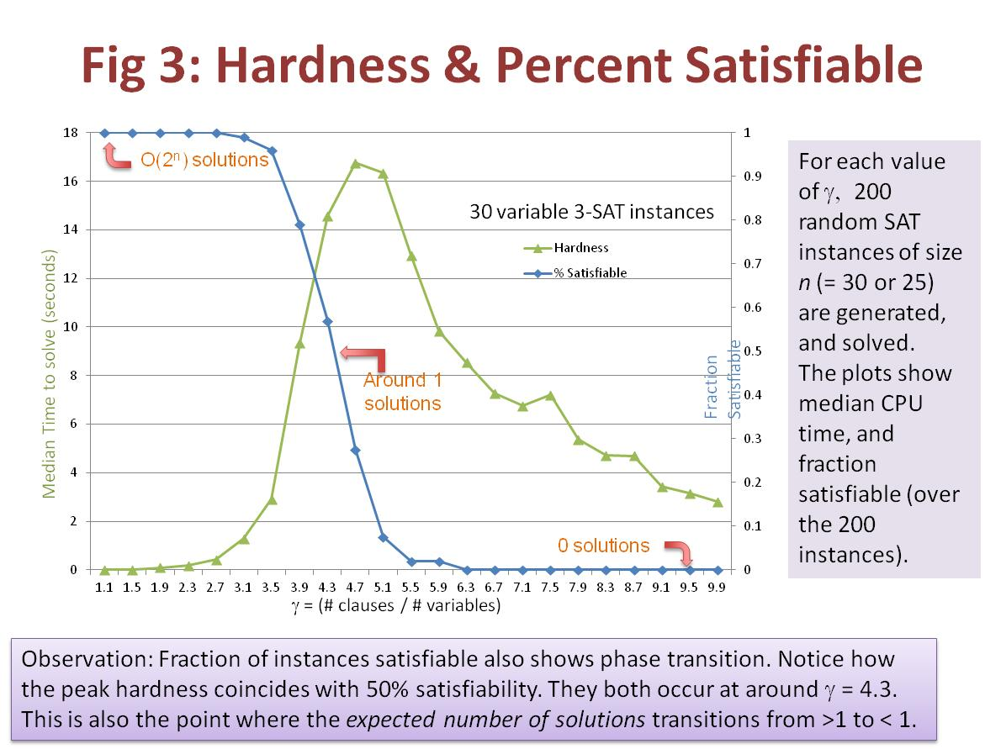
Very robust…
[From Soumya]

Slide 64
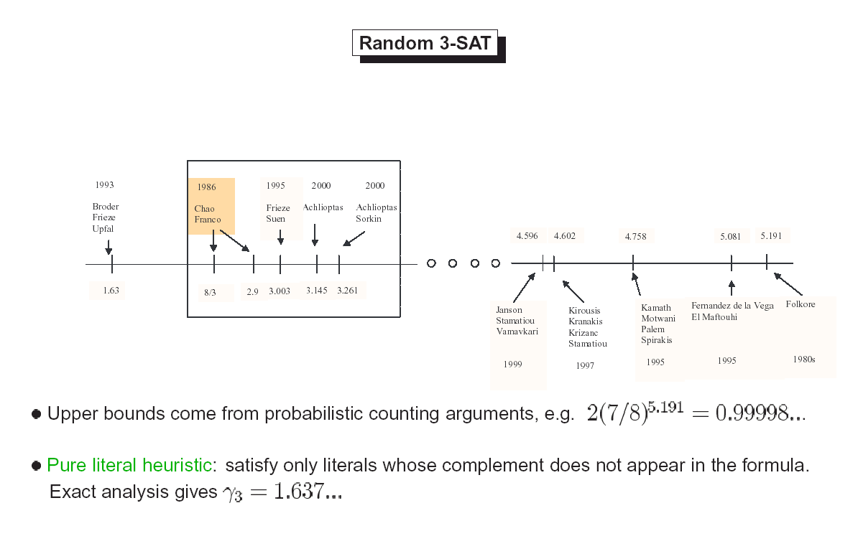
Progress in nailing the bound.. (just FYI)
http://www.ipam.ucla.edu/publications/ptac2002/ptac2002_dachlioptas_formulas.pdf

Slide 65
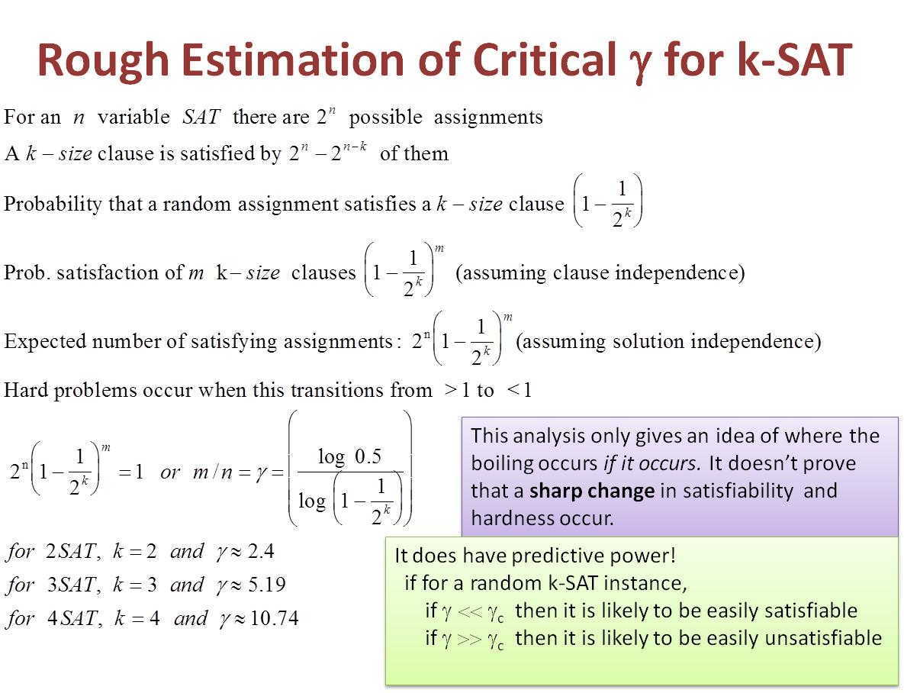
[From Soumya]

Slide 66
Facts
Objects
relations
FOPC
Prob
FOPC
Ontological
commitment
Prob
prop
logic
Prop
logic
facts
t/f/u
Epistemological
commitment
Deg
belief
Assertions;
t/f

